Slide 1

https://www.uni-goettingen.de/en/48115.html
UNPLAB-BrMeth_Ch-1[Intro]
Introduction into Plant Breeding Methodology and Plant Breeding in general
1

Slide 2
Sequential Number: #19
UNPLAB-BrMeth_Ch-1[Intro]
Unless I explicitly state otherwise, images and cartoons are created using ChatGPT.
You may use this material free of charge under the terms of the CC BY license. This requires that you provide appropriate attribution to the author: W. Link, University of Goettingen, Germany.
In a few cases, individual images, photographs, or similar material may be subject to a more restrictive Creative Commons license. Where this applies, it is explicitly indicated, and you must comply with the stated license terms for those items.
Please check the license information carefully before reuse. Responsibility for complying with the applicable license terms rests entirely with you.
2

Slide 3
You already know: Population Genetics. GxE interaction. h². Phenotypic Value, Genetic/Genotypic Value.
Selection Intensity. Breeders Equation.
Keywords of this chapter: The four Categories in Plant Breeding Methodology
Algebra as introduced in this chapter: None.
3

Slide 4
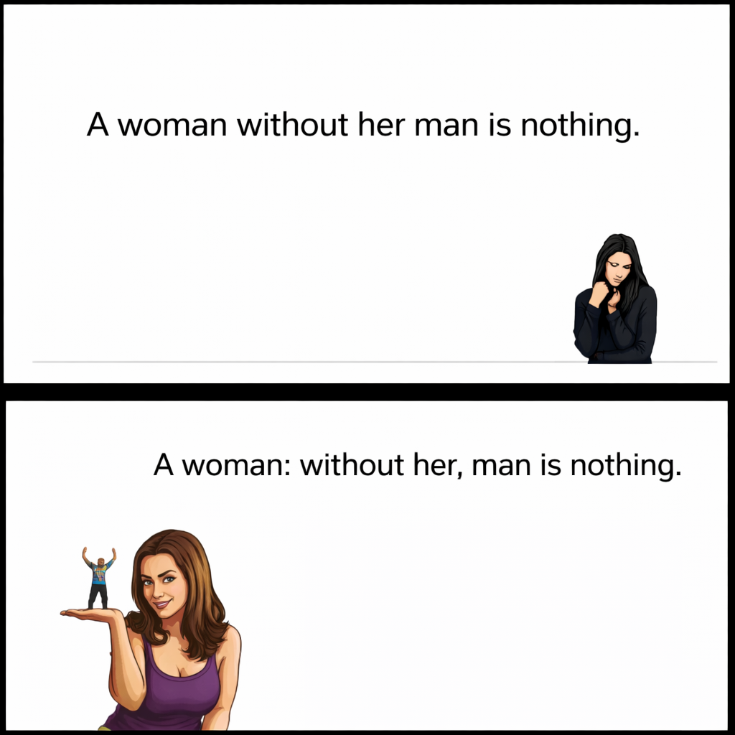
As academic agronomists and Plant Breeders, we don't usually sell things like potatoes or lentils. Rather, our product is knowledge. We 'sell' this through writing and speaking, often enriched with tables and diagrams ...
… and therefore, we must pay utmost awareness to the understand-ability, intelligibility, comprehensibility of our statements. Part of this is our employment of terms, of our specialist terms that we use. Spea-king to laymen, we must be aware that they may not be used to our specialist term; speaking to our peers, colleagues, we must make sure that we use the same, common term for the same meaning.
General Language as well as technical language is barely logic, is not a suitable area for dogmatism. Language is based on the 'un-spoken' agreement of ‘what means what’. Technical language is less about entertaining (no poetry) and more about conveying information effectively and precisely even if this, at times, leads to a boring style.
He says: „I test my clover individuals in five places this season“.
She understands: „He is excavating, moving and replanting the poor clover plants a lot“. He wanted to say: „I test my clover clones in five places this season“.
Again, mind the details, mind the term: ‘Individual’ or ‘Clone’? What about ‘Plant’, ‘Candidate’, ‘Accession’, ‘Line’, ‘Entry’ ?
Mind the details. Here, the detail is punctuation - and it changes everything.
4

Slide 5
Find here classical and present-day essays on how to organize the teaching and understanding of Plant Breeding Methods..
Fruwirth, C., 1922: Handbuch der landwirtschaftlichen Pflanzenzüchtung, Bd. 1, Edition 6, Berlin 1922.
Roemer, T., 1941: Überblick über die Methoden der Züchtung. In: Römer, T., und Rudorf, W., (eds.). Handbuch der Pflanzenzüchtung Bd. 1, Berlin (pp. 409-414.)
Hoffman, W., A. Mudra, W. Plarre, 1971: Lehrbuch der Züchtung landwirtschaftlicher Kulturpflanzen, Bd. 1. Allgemeiner Teil. Berlin and Hamburg.
Schnell, F.W., 1982: Die Züchtungssystematik von Carl Fruwirth und ihre Nachwirkungen. In: Winkel, H. (Ed), Geschichte und Naturwissenschaft in Hohehnheim. Jan Thorbecke Verlag, Sigmaringen.
Schnell, FWS, 1982. „Synoptic Study“. https://s.gwdg.de/qjxRYt
Peter DS Caligari,, 2001. https://s.gwdg.de/93SDEf
Breseghello F. and A.S.G Coelho, 2013: Traditional and Modern Plant Breeding Methods with Examples in Rice (Oryza sativa L.). Journal of Agricultural and Food Chemistry 61, 8277−8286.
Van den Wiel, C., Schaart, J., R. Niks., and R. Visser 2010: Traditional plant breeding methods. Report 338, Wageningen, UR Plant Breeding. https://s.gwdg.de/Qemqn3
For instance this text. The authors list – according to their own outline – plant breeding techniques, although the general title of the text reads ... methods. You can, e.g., release new diversity by techniques such as crossing and segregation, by mutagenesis, by genome editing – and this in potatoes (clone breeding) as well as in lentil (line breeding) or maize (hybrid breeding) or rye grass (population breeding).
See the flaw in this enumeration: Chairs, tables, sofa, cupboards, varnish-oil paint.
See the flaw in this enumeration: Line breeding, clone breeding, hybrid breeding, mutagenesis. ☺
5

Slide 6


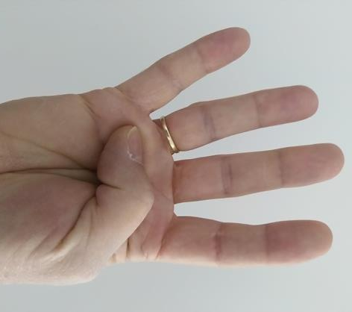
Orientation in the world: The map. Orientation in Plant Breeding: Categories.
© W. Link
6
Usually, we count N=7 continents: Europe, Asia, Africa, North America, South America, Australia, Antarctica. One may also count N=5: Eurasia, America, Africa, Australia, Antarctica.
In our framework, yet, we count N=4: Breeding Categories.

Slide 7
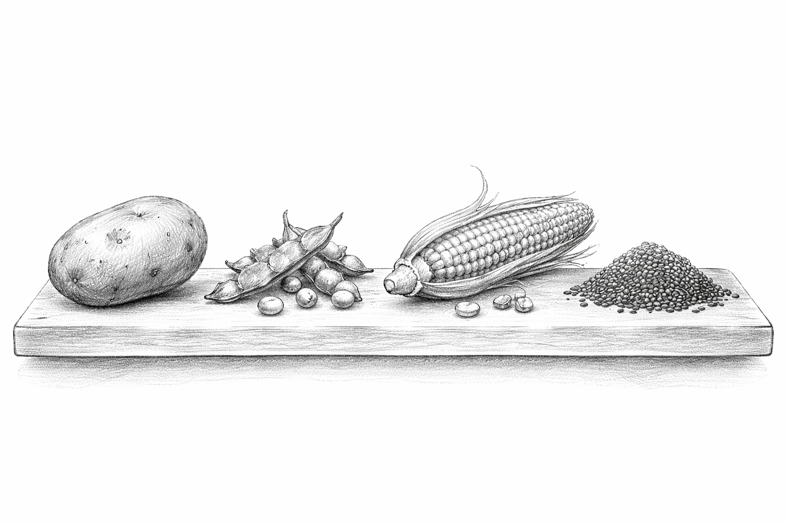
Plant Breeding Methods, the classical ones, fall in four Categories!
Clone Line Hybrid Population
7

Slide 8
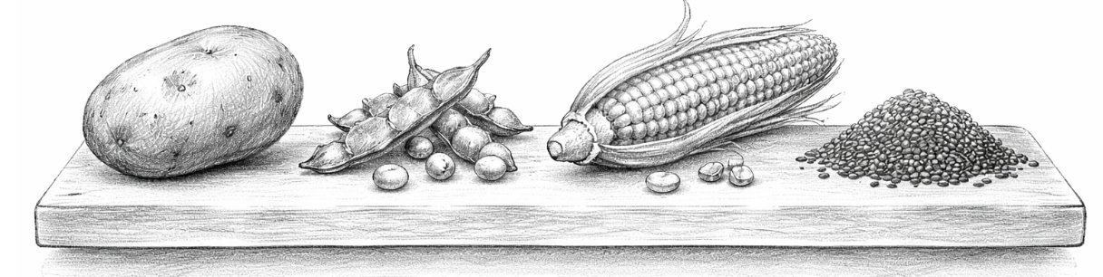
Plant Breeding Methods, the classical ones, fall in four categories!
8

Slide 9
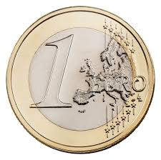
https://european-union.europa.eu/institutions-law-budget/institutions-and-bodies/search-all-eu-institutions-and-bodies/community-plant-variety-office-cpvo_en
https://www.bdp-online.de/en/Homepage/
The products of Plant Breeders are their plant Varieties (aka plant Cultivars).
Usually, such cultivars are single genotypes or, in cases, family-like groups of genotypes that have a taxonomic identity like ‘sub-sub-sub-(..) species’. This identity is guaranteed and protected by their phenotypic (and genetic) Distinctness and relative Uniformity and Stability across generations. A Cultivar is the seed lot from which it is sown as well as it is the crop plant stand in farmers fields, where it grows and produces yield. Here, cultivars are officially ‚released‘ cultivars. They have a name and went through a strict, standardized testing process (official field trials and more).
Selling so-called ‘certified’ seed (or tubers or other propagules) of released cultivars allows the breeder to earn money (royalties). In cases, farmers are allowed to re-sow seed of cvs. that they harvested on their own field (farm saved seed, farmers’ rights); then royalties are paid in a different way (not as share of the price of the certified seed). Usually, breeders are allowed to use any released cultivar for their own breeding (make crosses with them; breeders’ privilege). Specific rules apply in case of GMO (cvs. that carry trans-genes or the like; probably patented trans-genes ...).
These topics are wide research topics on their own (das Sortenwesen, the Plant variety and seed sector); I will talk about it here more or less … not any more.
§ 60a UrhG
§
9

Slide 10
From here you may go to UNPLAB-BrMeth_Ch-2[Heterosis]
10
10

